Slide 1
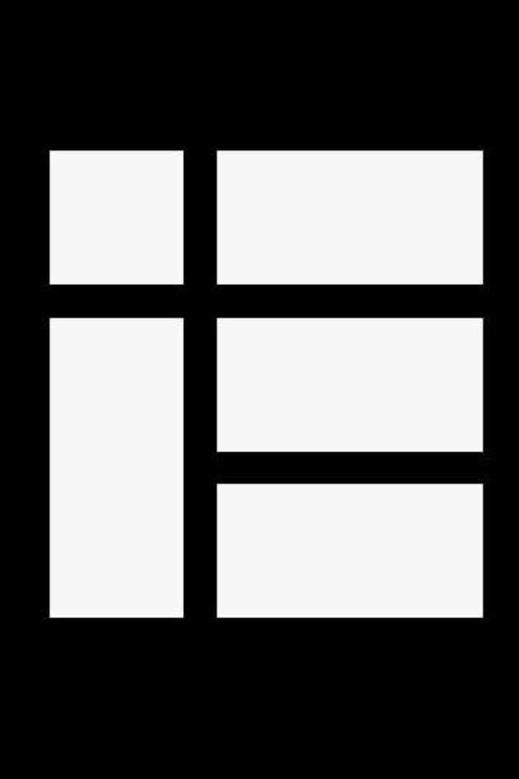

Kotlin Basics #1

Slide 2
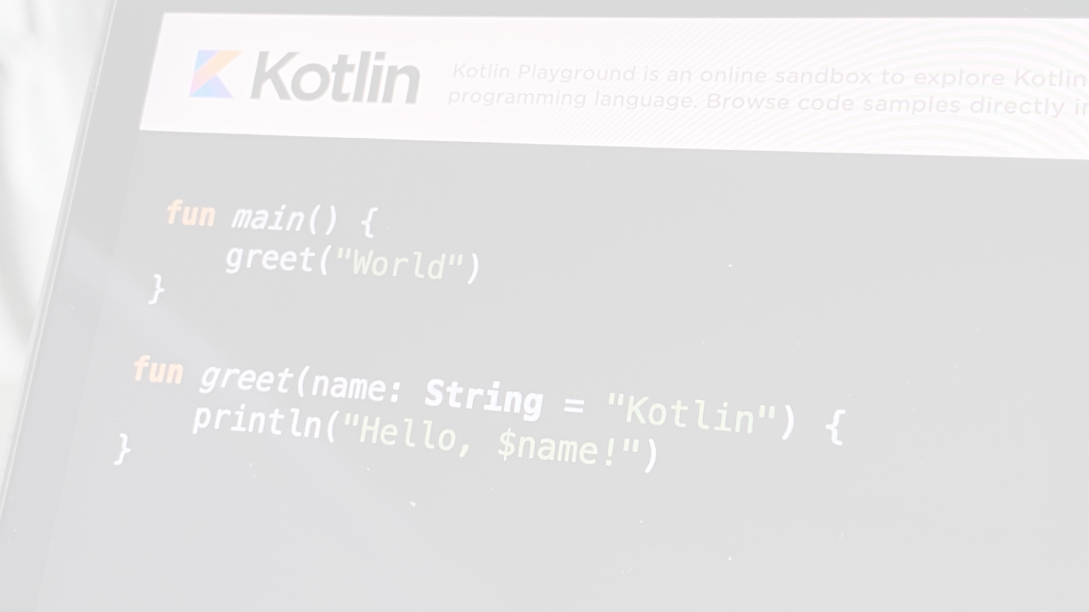
Package Definition and Imports﻿
Package specification should be at the top of the source file.
package my.demo
import kotlin.text.*
// ...
It is not required to match directories and packages: source files can be placed arbitrarily in the file system.

Slide 3
Program Entry Point﻿
An entry point of a Kotlin application is the main function.
fun main() {
println("Hello world!")
}
Another form of main accepts a variable number of String arguments.
fun main(args: Array<String>) {
args[0] = "ibrahim can"
println(args.contentToString())
}

Slide 4
Print to the Standard Output﻿
print prints its argument to the standard output.
print("Hello ")
print("world!")
println prints its arguments and adds a line break, so that the next thing you print appears on the next line.
println("Hello world!")
println(42)

Slide 5
Functions﻿
A function with two Int parameters and Int return type.
fun sum(a: Int, b: Int): Int {
return a + b
}
A function body can be an expression. Its return type is inferred.
fun sum(a: Int, b: Int) = a + b
A function that returns no meaningful value.
fun printSum(a: Int, b: Int): Unit {
println("sum of $a and $b is ${a + b}")
}
Unit return type can be omitted.
fun printSum(a: Int, b: Int) {
println("sum of $a and $b is ${a + b}")
}

Slide 6
Variables﻿
Read-only local variables are defined using the keyword val. They can be assigned a value only once.
val a: Int = 1 // immediate assignment
val b = 2 // `Int` type is inferred
val c: Int // Type required when no initializer is provided
c = 3 // deferred assignment
Variables that can be reassigned use the var keyword.
var x = 5 // `Int` type is inferred
x += 1
You can declare variables at the top level.
val PI = 3.14
var x = 0
fun incrementX() {
x += 1
}

Slide 7
Creating Classes & Instances﻿
To define a class, use the class keyword.
class Shape
Properties of a class can be listed in its declaration or body.
class Rectangle(val height: Double, val length: Double) {
val perimeter = (height + length) * 2
}
The default constructor with parameters listed in the class declaration is available automatically.
val rectangle = Rectangle(5.0, 2.0)
println("The perimeter is ${rectangle.perimeter}")
Inheritance between classes is declared by a colon (:). Classes are final by default; to make a class inheritable, mark it as open.
open class Shape
class Rectangle(val height: Double, val length: Double): Shape() {
val perimeter = (height + length) * 2
}

Slide 8
String Templates﻿
var a = 1
// simple name in template:
val s1 = "a is $a"
a = 2
// arbitrary expression in template:
val s2 = "${s1.replace("is", "was")}, but now is $a"

